Slide 1
Macro v. micro nutrients
Macro-nutrients
  Protein (amino acids)
  Energy (carbohydrates)
  Fat (fatty acids)
Micro-nutrients
  Water soluble vitamins (assist in energy-release of carbohydrates and red blood cell formation)
  Fat soluble vitamins (development & metabolism)
  Minerals

Slide 2
Macro-nutrients
Energy
  Necessary for all bodily function
Protein
  Necessary for structural development (muscle and bone)
Fat
  Necessary for cell membrane and skin cell development

Slide 3
Dietary Reference Intakes
Macronutrient | F (19-30 y.o.) | M (19-30 y.o.)
Energy (Kcal) Protein (g) | 1940 – 2200 36 – 46 | 2550 – 2900 44 – 60
Fat | 15 – 33% | 15 – 33%

Slide 4
Summary: Nutritional requirements
In order to live and function, humans need macro- and micro- nutrients;
Macro-nutrients are fat, protein and carbohydrates;
Micro-nutrients are water-soluble vitamins, fat-soluble vitamins, and minerals (bone and trace); the most critical micro-nutrients are iron, iodine, zinc, vitamin A and vitamin D.

Slide 5
What is malnutrition?
World Health Organization definition:
The term is used to refer to a number of diseases, each with a specific cause related to one or more nutrients (for example, protein, iodine or iron) and each characterized by cellular imbalance between the supply of nutrients and energy on the one hand, and the body's demand for them to ensure growth, maintenance, and specific functions, on the other.

Slide 6
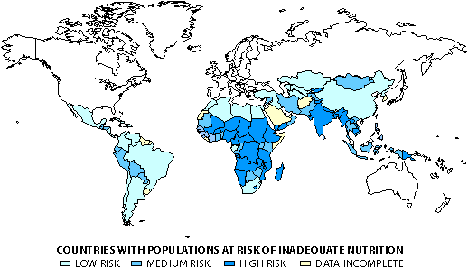
Countries at risk of malnutrition

Slide 7
Geneva Declaration
1924: Declaration of the Rights of the Child (also known as the Declaration of Geneva).
Adopted after World War I by the League of Nations through the efforts of British child rights pioneer
Marks the beginning of the international child rights movement and is also the first international affirmation of the right to nutrition.
Affirms that "the child must be given the means needed for its normal development, both materially and spiritually" and states that "the hungry child should be fed."
Notes:
1924: Declaration of the Rights of the Child (also known as the Declaration of Geneva). Adopted after World War I by the League of Nations through the efforts of British child rights pioneer Eglantyne Jebb, the Declaration marks the beginning of the international child rights movement and is also the first international affirmation of the right to nutrition. The Dec laration affirms that "the child must be given the means needed for its normal development, both materially and spiritually" and states that "the hungry child should be fed."

Slide 8
Summary: Definition of malnutrition
Malnutrition is having the inappropriate level of a micro- or macro- nutrient;
In some cases (i.e. the US), malnutrition can be associated with being grossly overweight;
In most of the world, malnutrition is defined as a LACK of nutrients;
Malnutrition contributes to over 50% of deaths in children in the world.

Slide 9
Causes of malnutrition
Child malnutrition
death and disability
Inadequate Disease
Diet
Poor water/ sanitation
inadequate health
services
Inadequate
maternal and
child care
Insufficient
access to food

Slide 10
Summary: Causes/correlates
Malnutrition rarely exists in isolation, and many other factors contribute to its detrimental impact;
  Poor physical resources, and overcrowded homes
  Poor sanitation and water supply
  Low income
  Parents with little education
  Minimal interaction/stimulation in the home
Malnutrition has repercussions throughout the life cycle and is thus multi-generational (diagram with lots of arrows)

Slide 11
Higher
mortality rate
Impaired
mental
development
Reduced
capacity
to care
for baby
Increased risk of
adult chronic disease
Baby
Low Birth
Weight
Elderly
Malnourished
Untimely/inadequate
weaning
Frequent
Infections
Inadequate
catch up
growth
Inadequate
food, health
& care
Inadequate
fetal
nutrition
Inadequate
food,
health
& care
Child
Stunted
Reduced
mental
capacity
Start here
Woman
Malnourished
Pregnancy
Low Weight
Gain
Adolescent
Stunted
Inadequate
food, health
& care
Reduced
mental
capacity
Higher
maternal
mortality
Inadequate
food, health
& care

Slide 12
Types of malnutrition
Severe Protein-Energy Malnutrition (>3 S.D.)
  Kwashiorkor (low protein)
  Marasmus (low calories)
Mild/moderate undernutrition (>2 S.D.)
  Stunting
  Underweight
  Wasting
Micro-nutrient deficiency
  Iodine
  Iron
  Vitamin A
  Vitamin D

Slide 13
Measurement of Malnutrition
STUNTING: Height for age – height compared to a reference population of the same age.
  = represents long term growth retardation
UNDERWEIGHT: Weight for age – weight compared to age in a reference population
WASTING: Weight for height – weight compared to a reference population of the same height.

Slide 14
Summary: Measurement
There are several types of malnutrition, micro- and macro-malnutrition;
Measurement of severe malnutrition (>3 S.D.) and micro-nutrient deficiency usually occurs due to presence of critical signs (to be discussed);
Measurement of mild/moderate malnutrition (>2 S.D.) occurs with growth charts.

Slide 15
Severe malnutrition % <5 y.o.
Developing Countries 12%
Least Developed Countries 13%
(India 21%, Bangladesh 21%, Cambodia 18%)
Data for 1992-98, UNICEF State of the World’s Children 2000
Notes:
Severe defined as below minus 3 standard deviations from median weight for age of reference population
Not a lot of good data (missing for almost half of countries in SOWC)
South Asia: India 21% Bangladesh 21%, Cambodia 18%
SSA: Madagascar 13%, Mali 17%, Niger 20%
US: 0%

Slide 16
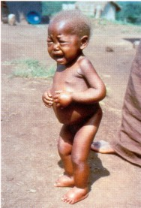
Kwashiorkor
Infection
Sparse
hair
Swollen
belly
Decreased
muscle
mass
Pellagra
Apathy
Notes:
Kwashiorkor: Sudden food deprivation due to natural or manmade emergencies produces a condition known as kwashiorkor. Apathy, swelling (oedema) of the extremities, torso and face, cracked, peeling, infection-prone skin and unnaturally blond, sparse hair are its visible characteristics.

Slide 17
Kwashiorkor (low protein)
Decreased muscle mass (failure to gain weight and of linear growth)
Swollen belly (edema and lipid build-up around the liver)
Changes in skin pigment (pellagra); may lose pigment where the skin has peeled away (desquamated) and the skin may darken where it has been irritated or traumatized
Hair lightens and thins, or becomes reddish and brittle.
Increased infections and increased severity of normally mild infection, diarrhea
Apathy, lethargy, irritability
➔ Death does not occur from actual starvation but from secondary infection

Slide 18
Kwashiorkor – mechanisms
Occurs in reaction to emergency situations (famine)
Kwashiorkor more likely in areas where cassava, yam, plantain, rice and maize are staples, not wheat
Increased carbohydrate intake with decreased protein intake eventually leads to edema (water) and fatty liver

Slide 19
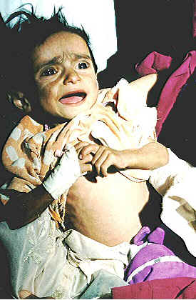
Marasmus (low calories)
Ravenously
hungry
Gross
weight
loss &
no fat

Slide 20
Marasmus
Deficit in calories – “marasmus” comes from Greek origin of word “to waste”
Gross weight loss
Hyper-alert and ravenously hungry
Children have no subcutaneous fat or muscle
➔ eventually starve to death (immediate cause often is pneumonia)
Notes:
As a result, fat and muscle tissue are depleted, and the skin hangs in loose folds with the bones clearly visible beneath. Hyper-alert and ravenously hungry, this child's severe wasting

Slide 21
Marasmus – mechanism
Energy intake is insufficient for body’s requirements – body must draw on own stores
Liver glycogen exhausted in a few hours – skeletal muscle protein used via gluconeogenesis to maintain adequate plasma glucose
When near starvation is prolonged, fatty acids are incompletely oxidized to ketone bodies, which can be used by brain and other organs for energy
High cortisol and growth hormone levels
➔ Mechanism is same as anorexia

Slide 22
Severe Malnutrition: Consequences
Mental development
  Lower IQ levels
  Poorer school performance
Behaviors of recovered severely malnourished children
  shy, isolated, withdrawn
  decreased attention span
  immature, emotionally unstable
  fewer peer relationships/reduced social skills
  played less/stayed nearer to mothers

Slide 23
Summary: Severe malnutrition
Severe malnutrition is defined as > 3 s.d. away from median reference standards;
66M children under the age of 5 are severely malnourished (64M of these in developing countries);
Key types of severe malnutrition are kwashiorkor (low protein) and marasmus (low calories);
Severe malnutrition results in severe deficits for children

Slide 24
Stunting – Height for Age
Height for age reflects pre- and post- natal linear growth
“Stunting” refers to shortness that is not genetic, but due to poor health or nutrition
Most standard definition < 2 S.D.
Stunting is good cumulative measure of “well-being” for populations of children (because not affected by weight recovery)

Slide 25
Where do we go from here?
Poverty
reduction
Economic growth
Increased
productivity
Improved child
nutrition
Social sector
investments
Enhanced human
capital
From UNICEF, State of the World’s Children: Adapted from Stuart Gillespie, John Mason and Reynaldo Martorell, How nutrition improves, ACC/SCN, Geneva 1996.

